Slide 1
Deep Learning Models and Challenges
R. K. Agrawal
School of Computer and Systems Sciences
Jawaharlal Nehru University
NewDelhi-110067

Slide 2
Outline
Typical goal of machine Learning
Neural Network
Single Perceptron
Multilayer Perceptron
Deep learning
Some common deep learning algorithms
Challenges
*Many of slides adapted from Andrew Ng and G . Hinton

Slide 3
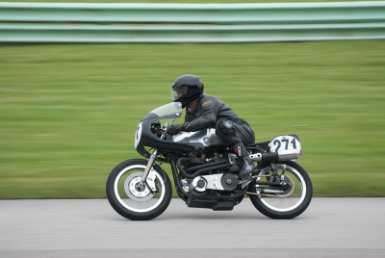
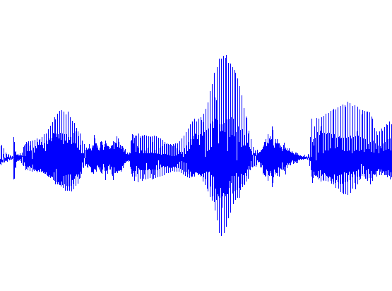

Typical goal of machine learning
input
output
Label: “Motorcycle”
Suggest tags
Image search
…
images/video
ML
Speech recognition
Music classification
Speaker identification
…
audio
ML
Web search
Anti-spam
Machine translation
…
text
ML

Slide 4


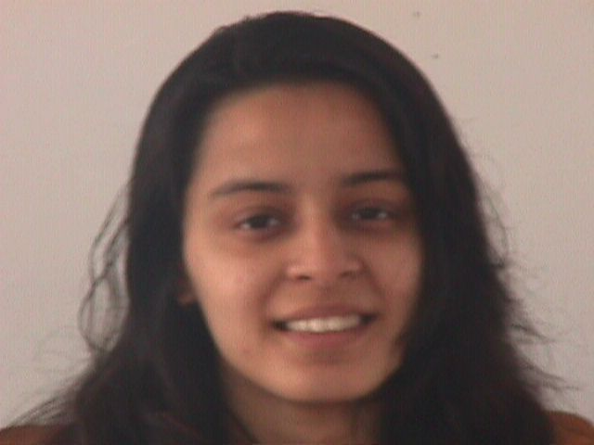
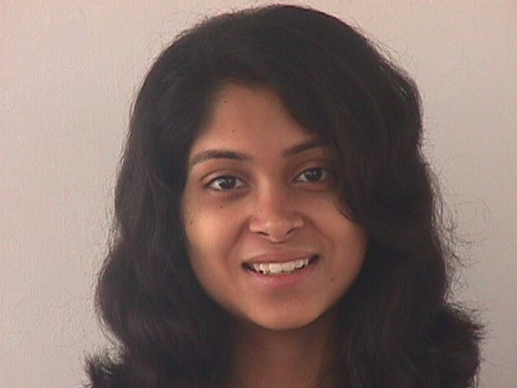
Face Recognition

Slide 5
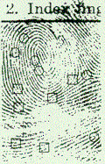
Fingerprint recognition

Slide 6
Optical Character Recognition

Slide 7
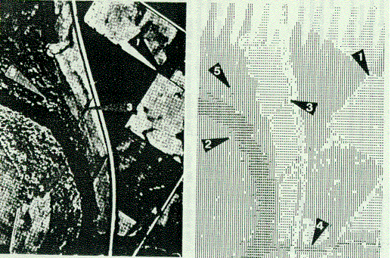
Detection of Oil Slicks
Given radar satellite images of coastal waters
Problem: Detect Oil Slicks

Slide 8
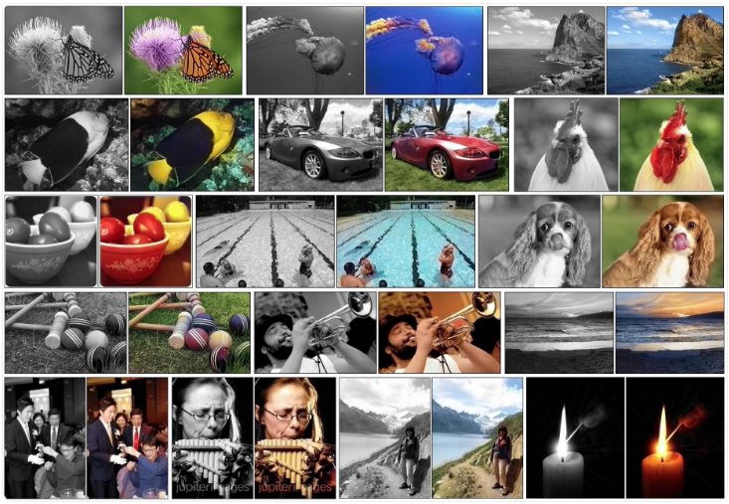
Automatic Colorization of Images

Slide 9
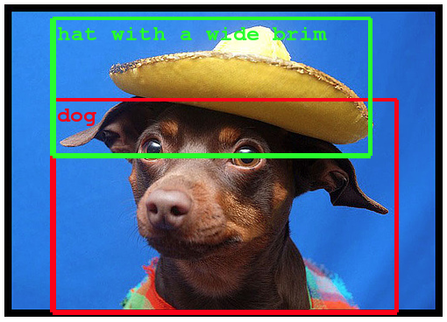
Object Classification/Detection in Photographs

Slide 10
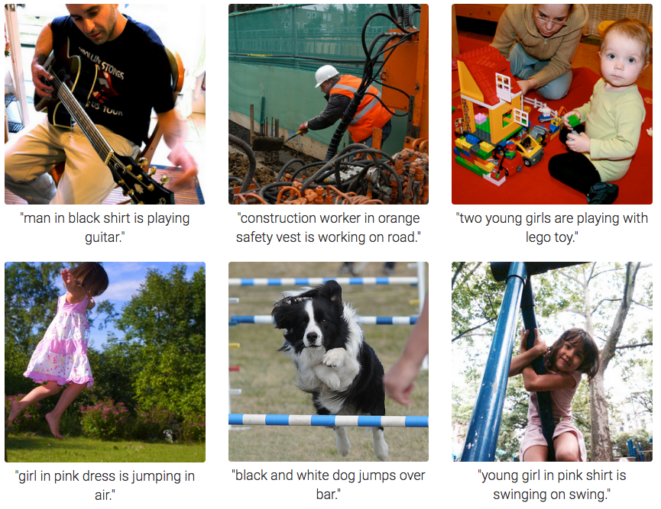
Automatic Image Caption Generation

Slide 11

Health Care

Slide 12
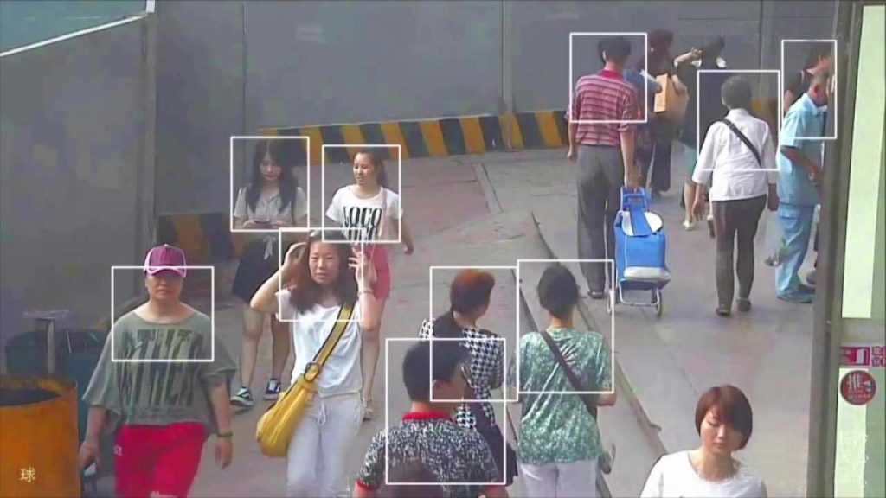
Real-Time Analysis of Behavior

Slide 13
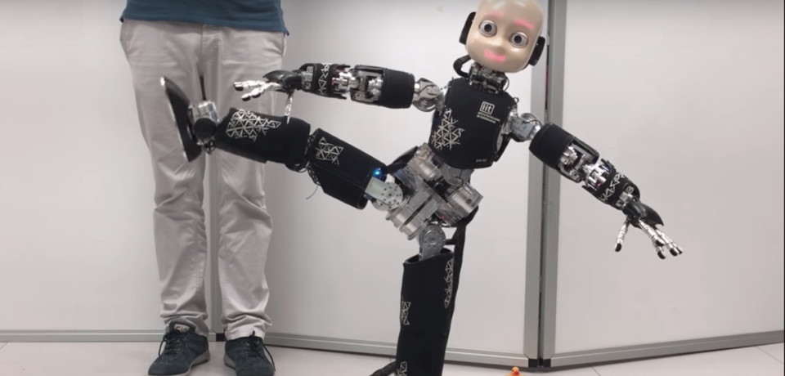
Robotics

Slide 14
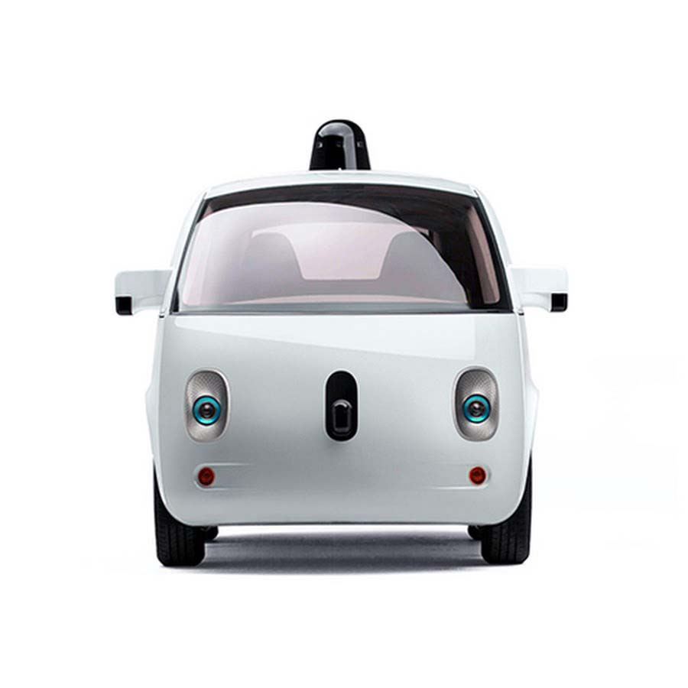
Self-Driving Cars

Slide 15
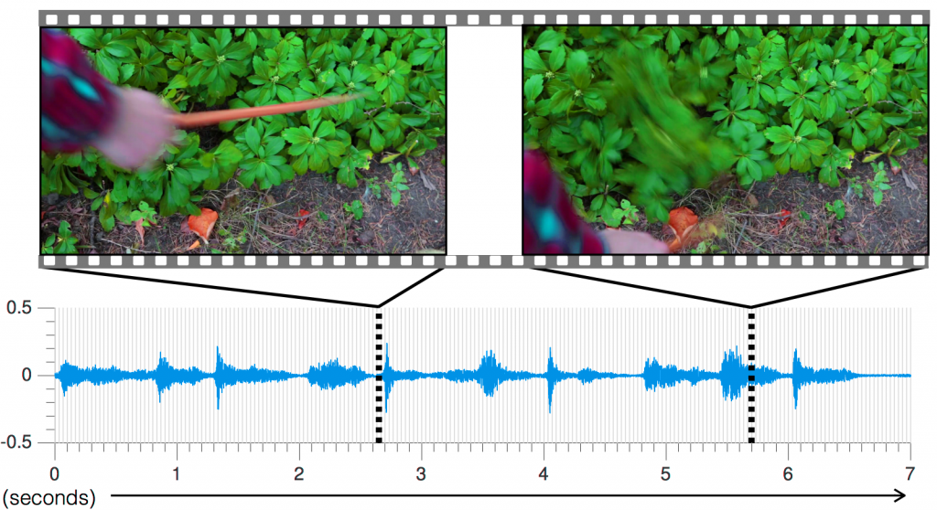
Including Sound in Videos

Slide 16


Slide 17


Slide 18



Slide 19

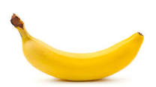

Slide 20


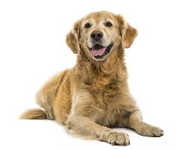

Slide 21
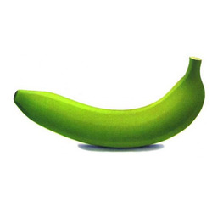
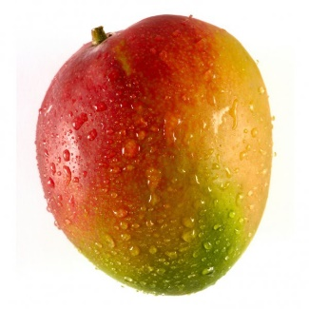
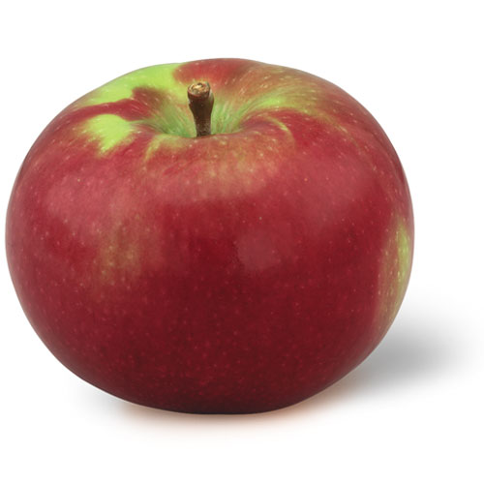
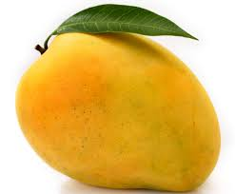
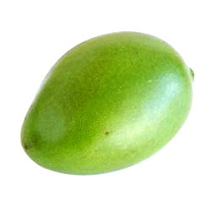
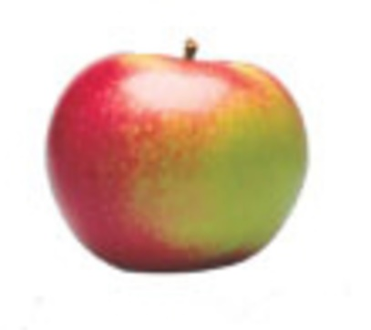
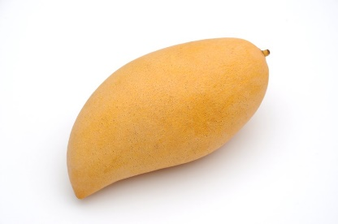

Slide 22
Apple
Banana
Mango

Slide 23
Fruit
Name of Fruit
Apple
Banana
Mango
f(Fruit) Name of Fruit

Slide 24
Classification
f(Feature_vec) Fruit_type
Feature Vector |  | Fruit_type
Color | Shape
Red | Elliptical | Apple
Yellow | Elongated | Banana
Yellow | Elliptical | Mango
Green | Elliptical | Mango
Green | Elongated | Banana

Slide 25
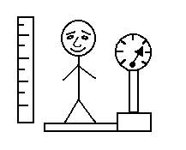
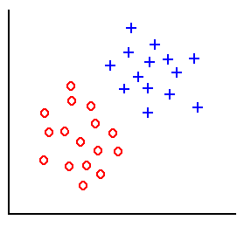
Classification
height
weight
Training examples

Slide 26
Classification
height
weight
Training examples
D_{i} = distance(x, x_{i}), i=1,2,…,l

Slide 27
Classification
height
weight
Training examples
Linear classifier:
w.x + w₀ = 0

Slide 28
Classification
height
weight
Training examples
Linear classifier:
w.x + w₀ = 0

Slide 29
Decision Surface of a Perceptron
x₂
x₂
x₁
x₁
Linearly separable (AND Problem)
Linearly separable (NAND Problem)
For AND
X₁ X₂ y
0 0 0
0 1 0
1 0 0
1 1 1
For NAND
X₁ X₂ y
0 0 1
0 1 1
1 0 1
1 1 0

Slide 30
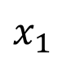
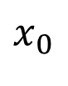
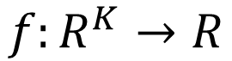

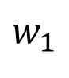
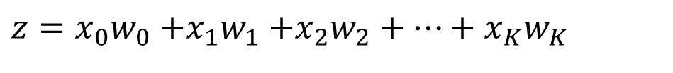
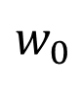
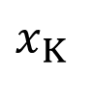
Elements of Neural Network
Neuron
$$f:R^{K}→R$$
$$x_{0}$$
$$z={x_{0}w}_{0}{+x_{1}w}_{1}+x_{2}w_{2}+⋯+x_{K}w_{K}$$
$$w_{0}$$
$$x_{1}$$
$$w_{1}$$
h(z)
…
$$w_{K}$$
$$x_{K}$$
Activation function
weights
Notes:
sigmoid

Slide 31
Elements of Neural Network
Neuron
$$f:R^{K}→R$$
$$x_{0}$$
$$z={x_{0}w}_{0}{+x_{1}w}_{1}+x_{2}w_{2}+⋯+x_{K}w_{K}$$
$$w_{0}$$
$$x_{1}$$
$$w_{1}$$
h(z)
…
$$w_{K}$$
$$x_{K}$$
weights
Activation function
1 if Σ w_{i} x_{i} > 0
h(z)=
0 otherwise
Notes:
sigmoid

Slide 32
Training Perceptrons
For AND
X₁ X₂ y
0 0 0
0 1 0
1 0 0
1 1 1
X₀
W₀ = ?
X₁
th= 0.0
W₁ = ?
W₂ = ?
X₂
Initialize with random weight values

Slide 33
Training Perceptrons
For AND
X₁ X₂ y
0 0 0
0 1 0
1 0 0
1 1 1
X₀
W₀ = -0.3
X₁
th= 0.0
W₁ = 0.5
W₂ = -0.4
X₂

Slide 34
Gradient Descent Learning Rule
Train the w_{i}’s such that they minimize the squared error
E[w₁,…,w_{n}] = ½ Σ_{d∈D} (y_{d}-h_{d})²
where D is the set of training examples

Slide 35
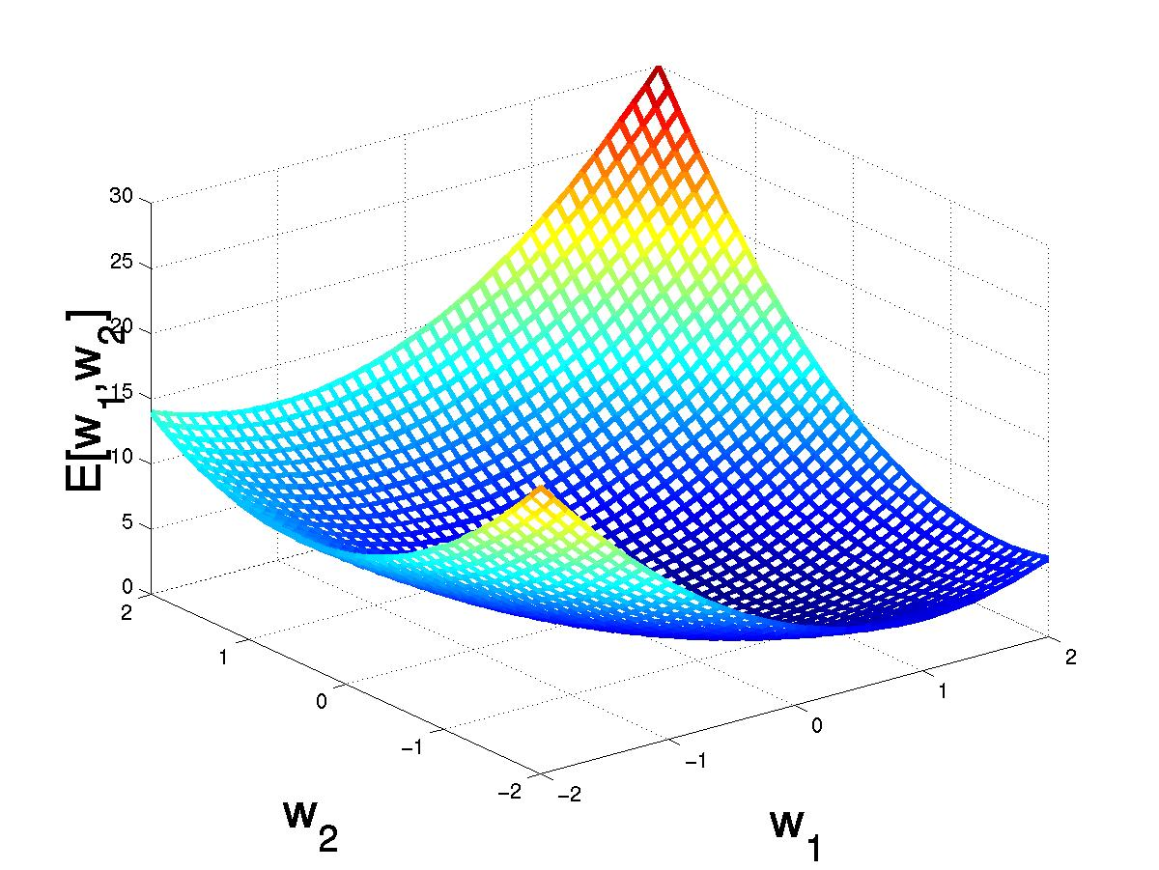
Gradient Descent
(w₁,w₂)
Gradient:
∇E[w]=[∂E/∂w₀,… ∂E/∂w_{n}]
Δw=- η∇E[w]
(w₁+Δw₁,w₂ +Δw₂)
Δw_{i}=- η∂E/∂w_{i}
=- η∂/∂w_{i} 1/2Σ_{d}(y_{d}-h_{d})²
= -η ∂/∂w_{i} 1/2Σ_{d}(y_{d}-Σ_{i} w_{i} x_{i})²
= η Σ_{d}(y_{d}- h_{d})(x_{i})
Consider 0<η <=1

Slide 36
Weight Updation
For AND
X₁ X₂ y
0 0 0
0 1 0
1 0 0
1 1 1
W₀= -0.3 + [(0-0)1+(0-0)1+(0-1)1+(1-0)1]= -0.3
W₁= 0.5 + [(0-0)0+(0-0)0+(0-1)1+(1-0)1]= 0.5
W₂= -0.4 + [(0-0)0+(0-0)1+(0-1)0+(1-0)1]= 0.6

Slide 37
Weight Updation
For AND
X₁ X₂ y
0 0 0
0 1 0
1 0 0
1 1 1
W₀= -0.3 + [(0-0)1+(0-1)1+(0-1)1+(1-1)1]= -2.3
W₁= 0.5 + [(0-0)0+(0-1)0+(0-1)1+(1-1)1]= -0.5
W₂= 0.6 + [(0-0)0+(0-1)1+(0-1)0+(1-1)1]= -0.4

Slide 38
Weight Updation
For AND
X₁ X₂ y
0 0 0
0 1 0
1 0 0
1 1 1
W₀= -2.3 + [(0-0)1+(0-0)1+(0-0)1+(1-0)1]= -1.3
W₁= -0.5 + [(0-0)0+(0-0)0+(0-0)1+(1-0)1]= 0.5
W₂= -0.4 + [(0-0)0+(0-0)1+(0-0)0+(1-0)1]= 0.6

Slide 39
Weight Updation
For AND
X₁ X₂ y
0 0 0
0 1 0
1 0 0
1 1 1
W₀= -1.3 + [(0-0)1+(0-0)1+(0-0)1+(1-0)1]= -0.3
W₁= 0.5 + [(0-0)0+(0-0)0+(0-0)1+(1-0)1]= 1.5
W₂= 0.6 + [(0-0)0+(0-0)1+(0-0)0+(1-0)1]= 1.6

Slide 40
Weight Updation
For AND
X₁ X₂ y
0 0 0
0 1 0
1 0 0
1 1 1
W₀= -0.3 + [(0-0)1+(0-0)1+(0-1)1+(1-1)1]= -1.3
W₁= 1.5 + [(0-0)0+(0-0)0+(0-1)1+(1-1)1]= 0.5
W₂= 1.6 + [(0-0)0+(0-0)1+(0-1)0+(1-1)1]= 1.6

Slide 41
Weight Updation
For AND
X₁ X₂ y
0 0 0
0 1 0
1 0 0
1 1 1
W₀= -1.3 + [(0-0)1+(0-1)1+(0-0)1+(1-1)1]= -2.3
W₁= 0.5 + [(0-0)0+(0-1)0+(0-0)1+(1-1)1]= 0.5
W₂= 1.6 + [(0-0)0+(0-1)1+(0-0)0+(1-1)1]= 0.6

Slide 42
Weight Updation
For AND
X₁ X₂ y
0 0 0
0 1 0
1 0 0
1 1 1
W₀= -2.3 + [(0-0)1+(0-0)1+(0-0)1+(1-0)1]= -1.3
W₁= 0.5 + [(0-0)0+(0-0)0+(0-0)1+(1-0)1]= 1.5
W₂= 0.6 + [(0-0)0+(0-0)1+(0-0)0+(1-0)1]= 1.6

Slide 43
Weight Updation
For AND
X₁ X₂ y
0 0 0
0 1 0
1 0 0
1 1 1
W₀= -1.3 + [(0-0)1+(0-1)1+(0-1)1+(1-1)1]= -3.3
W₁= 1.5 + [(0-0)0+(0-1)0+(0-1)1+(1-1)1]= 0.5
W₂= 1.6 + [(0-0)0+(0-1)1+(0-1)0+(1-1)1]= 0.6

Slide 44
Weight Updation
For AND
X₁ X₂ y
0 0 0
0 1 0
1 0 0
1 1 1
W₀= -3.3 + [(0-0)1+(0-0)1+(0-0)1+(1-0)1]= -2.3
W₁= 0.5 + [(0-0)0+(0-0)0+(0-0)1+(1-0)1]= 1.5
W₂= 0.6 + [(0-0)0+(0-0)1+(0-0)0+(1-0)1]= 1.6

Slide 45
Decision Surface of a Perceptron
x₂
x₂
x₁
x₁
Linearly separable (AND Problem)
Linearly separable (NAND Problem)
For AND
X₁ X₂ y
0 0 0
0 1 0
1 0 0
1 1 1
For NAND
X₁ X₂ y
0 0 1
0 1 1
1 0 1
1 1 0

Slide 46
Decision Surface of a Perceptron
x₂
x₂
x₁
x₁
Linearly separable (OR Problem)
NonLinearly separable (XOR Problem)
For OR
X₁ X₂ y
0 0 0
0 1 1
1 0 1
1 1 1
For XOR
X₁ X₂ y
0 0 0
0 1 1
1 0 1
1 1 0

Slide 47
Decision Surface of a Perceptron
x₂
XOR can solved as:
XOR(x₁, x₂)= AND( OR(x₁, x₂), NAND(x₁, x₂))
x₁
NonLinearly separable (XOR Problem)
For XOR
X₁ X₂ y
0 0 0
0 1 1
1 0 1
1 1 0

Slide 48
XOR Problem
OR
x0
AND
x1
NAND
x2
XOR(x₁, x₂)= AND( OR(x₁, x₂), NAND(x₁, x₂))

Slide 49
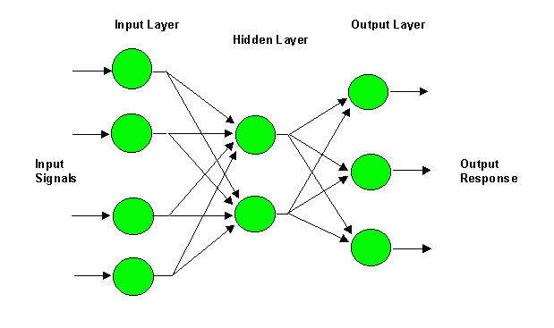
Multilayer Perceptron (MLP)
i
W_{ji}
j
W_{kj}
k

Slide 50
Multilayer Perceptron (MLP)
i
W_{ji}
j
W_{kj}
k
y_{j} = f(net_{j})
z_{k} = f(net_{k})

Slide 51
Multilayer Perceptron (MLP)
Δw_{kj} = ηδ_{k}y_{j} = η(t_{k} – z_{k}) f’ (net_{k})y_{j}

Slide 52
Multilayer Perceptron (MLP)

Slide 53
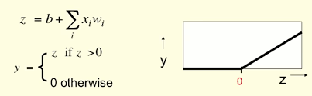
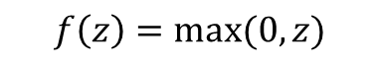
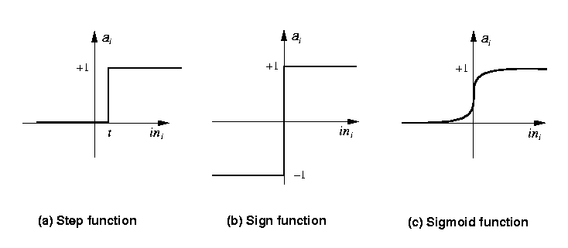
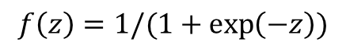
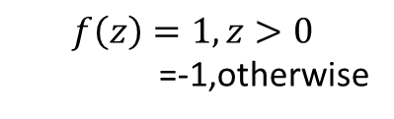
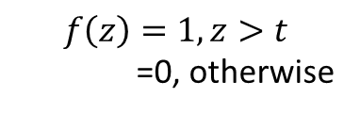
Activation functions
$$f\left(z\right)=1, z>t$$
=0, otherwise
$$f\left(z\right)=1, z>0$$
=-1,otherwise
$$f\left(z\right)=1/(1+\exp\left(−z\right))$$
Rectified Linear Unit
$$f\left(z\right)=max⁡(0,z)$$

Slide 54
Confusion Matrix
Actual class\Predicted class | P | _{N}
P | True Positives (TP) | False Negatives (FN)
N | False Positives (FP) | True Negatives (TN)

Slide 55
Evaluation Metrics
Classifier Accuracy, or recognition rate: percentage of test set tuples that are correctly classified
Accuracy = (TP + TN)/All
Error rate: 1 – accuracy, or
Error rate = (FP + FN)/All
Sensitivity: True Positive recognition rate
Sensitivity = TP/P
Specificity: True Negative recognition rate
Specificity = TN/N
55

Slide 56
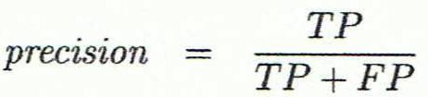
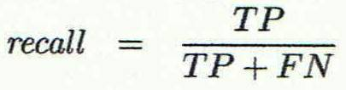
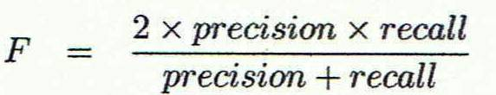
Evaluation Metrics
Precision: exactness – what % of tuples that the classifier labeled as positive are actually positive
Recall: completeness – what % of positive tuples did the classifier label as positive?
Inverse relationship between precision & recall
F measure (F₁ or F-score): harmonic mean of precision and recall,
56

Slide 57
Receiver Operating Characteristics (ROC )Curves
The area under the ROC curve is a measure of the accuracy of the model
A model with perfect accuracy will have an area of 1.0
57

Slide 58
Multilayer Perceptron (MLP)
i
W_{ji}
j
W_{kj}
k
y_{j} = f(net_{j})
z_{k} = f(net_{k})

Slide 59
Universal Function Approximator
A one hidden layer FFNN with sufficiently large number of hidden nodes can approximate any function (Hornik, 1991)

Slide 60
Handwritten Character Recognition
Image size= 100 x 100
No. of nodes at hidden layer= 10⁶
No. of Classes =26
No. of Weights to be learned= 10¹⁰

Slide 61
Shallow vs Deep
Functions that can be compactly represented by a depth k architecture with fewer computational elements might require an larger number of computational elements to be represented by a depth k − 1 architecture.
Consequences are:
▪ Computational: We don’t need exponentially many elements in the layers
▪ Statistical: poor generalization may be expected when using an insufficiently deep architecture for representing some functions

Slide 62


Slide 63
Deep Learning
Multilayer neural networks have been around for
25 years. What’s actually new?
We had good algorithms for learning the weights in networks with 1 or 2 hidden layer(s)
But these algorithms are not good at learning the weights for networks with more hidden layers

Slide 64
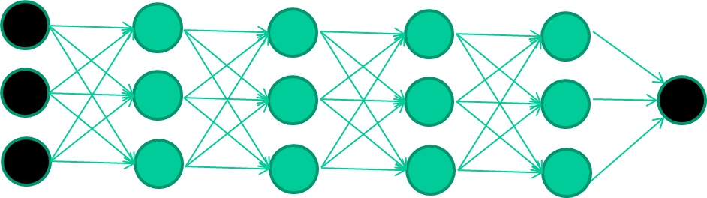
New way to train multi-layer NNs…

Slide 65
New way to train multi-layer NNs…
Train this layer first

Slide 66
New way to train multi-layer NNs…
Train this layer first
then this layer

Slide 67
New way to train multi-layer NNs…
Train this layer first
then this layer
then this layer

Slide 68
New way to train multi-layer NNs…
Train this layer first
then this layer
then this layer
then this layer

Slide 69
New way to train multi-layer NNs…
Train this layer first
then this layer
then this layer
then this layer
finally this layer

Slide 70
New way to train multi-layer NNs…
EACH of the (non-output) layers is trained to be an autoencoder
Basically, it is forced to learn good features that describe what comes from the previous layer

Slide 71
Autoencoder
x₁
x₂
x₃

Slide 72
Autoencoder
x₁
x₁
x₂
x₂
x₃
x₃

Slide 73
Autoencoder
x₁
x₁
x₂
x₂
x₃
x₃

Slide 74














What is Deep Learning?
Data
Feature extraction
Prediction model
Conventional Machine Learning pipeline
Deep prediction model
Data
Feature extraction
Feature learning
Prediction
Deep Learning

Slide 75
Disadvantages of Neural Networks
The number of trainable parameters becomes extremely large
Little or no invariance to shifting, scaling, and other forms of distortion
The topology of the input data is completely ignored

Slide 76
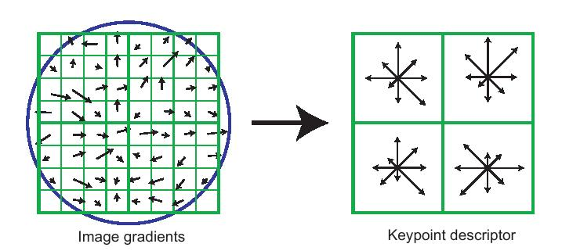
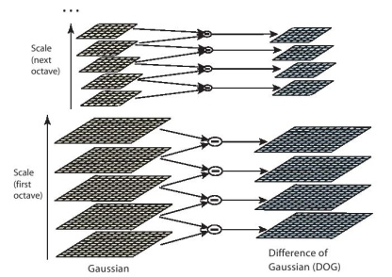
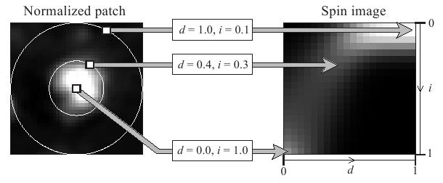
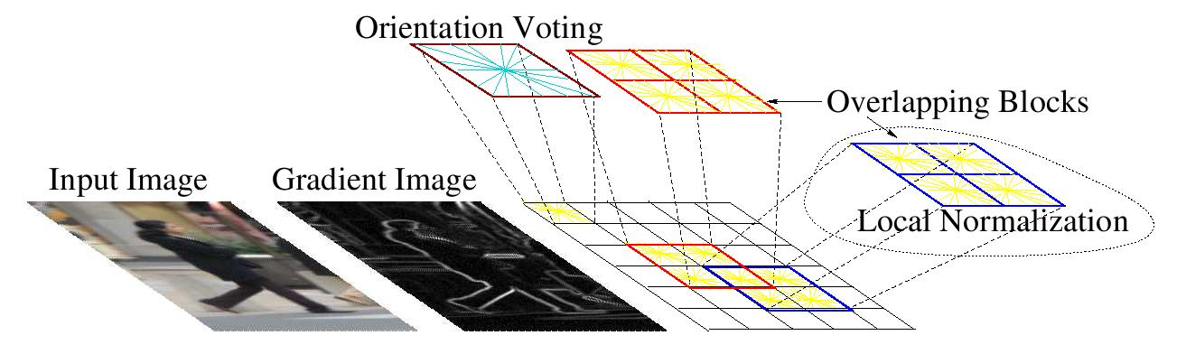
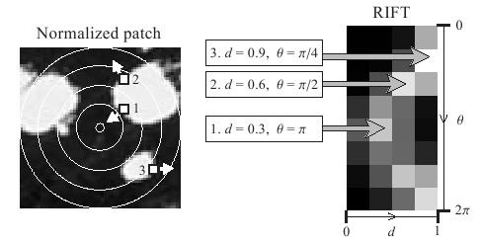
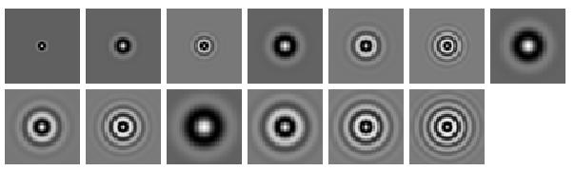
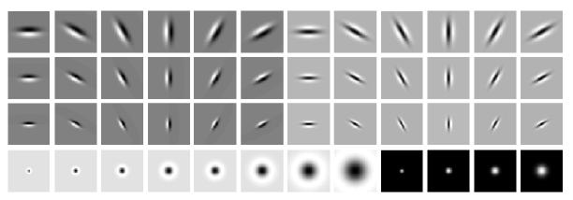


Some feature representations
SIFT
Spin image
HoG
RIFT
Textons
GLOH

Slide 77
Some feature representations
Coming up with features is often difficult, time-consuming, and requires expert knowledge.
SIFT
Spin image
HoG
RIFT
Textons
GLOH

Slide 78
Convolutional Neural Network (CNN)
CNNs have much fewer connections and parameters in comparison to similar size ANN and so they are easier to train

Slide 79

Building Blocks

Slide 80

Edge Operators
Good Localization
Gradient:
Noise Sensitive Poor Detection
Roberts (2 x 2):
Sobel (3 x 3):
0 | 1
-1 | 0
1 | 0
0 | -1
-1 | 0 | 1
-1 | 0 | 1
-1 | 0 | 1
1 | 1 | 1
0 | 0 | 0
-1 | -1 | 1
Sobel (5 x 5):
-1 | -2 | 0 | 2 | 1
-2 | -3 | 0 | 3 | 2
-3 | -5 | 0 | 5 | 3
-2 | -3 | 0 | 3 | 2
-1 | -2 | 0 | 2 | 1
1 | 2 | 3 | 2 | 1
2 | 3 | 5 | 3 | 2
0 | 0 | 0 | 0 | 0
-2 | -3 | -5 | -3 | -2
-1 | -2 | -3 | -2 | -1
Poor Localization Less Noise Sensitive Good Detection

Slide 81
Sobel Edges

Slide 84


Feature detectors

Slide 85
vertical lines
1
63

Slide 86
Horizontal lines
1
63

Slide 87
Small circles
1
63

Slide 88
Small circles
1
But what about position invariance ???
our example unit detectors were tied to
specific parts of the image
63

Slide 89

Going deep
object models
object parts
(combination
of edges)
edges
Training set: Aligned
images of faces.
pixels
[Honglak Lee]

Slide 90

Convolutional Neural Network (CNN)

Slide 91
Convolution
These are the network parameters to be learned.
1 | -1 | -1
-1 | 1 | -1
-1 | -1 | 1
1 | 0 | 0 | 0 | 0 | 1
0 | 1 | 0 | 0 | 1 | 0
0 | 0 | 1 | 1 | 0 | 0
1 | 0 | 0 | 0 | 1 | 0
0 | 1 | 0 | 0 | 1 | 0
0 | 0 | 1 | 0 | 1 | 0
Filter 1
-1 | 1 | -1
-1 | 1 | -1
-1 | 1 | -1
Filter 2
……
6 x 6 image
Each filter detects a small pattern (3 x 3).

Slide 92
Convolution
1 | -1 | -1
-1 | 1 | -1
-1 | -1 | 1
Filter 1
stride=1
1 | 0 | 0 | 0 | 0 | 1
0 | 1 | 0 | 0 | 1 | 0
0 | 0 | 1 | 1 | 0 | 0
1 | 0 | 0 | 0 | 1 | 0
0 | 1 | 0 | 0 | 1 | 0
0 | 0 | 1 | 0 | 1 | 0
Dot
product
3
-1
6 x 6 image

Slide 93
Convolution
1 | -1 | -1
-1 | 1 | -1
-1 | -1 | 1
Filter 1
If stride=2
1 | 0 | 0 | 0 | 0 | 1
0 | 1 | 0 | 0 | 1 | 0
0 | 0 | 1 | 1 | 0 | 0
1 | 0 | 0 | 0 | 1 | 0
0 | 1 | 0 | 0 | 1 | 0
0 | 0 | 1 | 0 | 1 | 0
3
-3
6 x 6 image

Slide 94
Convolution
1 | -1 | -1
-1 | 1 | -1
-1 | -1 | 1
Filter 1
stride=1
1 | 0 | 0 | 0 | 0 | 1
0 | 1 | 0 | 0 | 1 | 0
0 | 0 | 1 | 1 | 0 | 0
1 | 0 | 0 | 0 | 1 | 0
0 | 1 | 0 | 0 | 1 | 0
0 | 0 | 1 | 0 | 1 | 0
3
-1
-3
-1
-3
1
0
-3
-3
-3
0
1
3
-2
-2
-1
6 x 6 image

Slide 95
Convolution
-1 | 1 | -1
-1 | 1 | -1
-1 | 1 | -1
Filter 2
stride=1
Repeat this for each filter
1 | 0 | 0 | 0 | 0 | 1
0 | 1 | 0 | 0 | 1 | 0
0 | 0 | 1 | 1 | 0 | 0
1 | 0 | 0 | 0 | 1 | 0
0 | 1 | 0 | 0 | 1 | 0
0 | 0 | 1 | 0 | 1 | 0
3
-1
-3
-1
-1
-1
-1
-1
-3
1
0
-3
-1
-1
-2
1
Feature
Map
-3
-3
0
1
-1
-1
-2
1
3
-2
-2
-1
6 x 6 image
-1
0
-4
3
Two 4 x 4 images
Forming 2 x 4 x 4 matrix

Slide 96

1 | -1 | -1
-1 | 1 | -1
-1 | -1 | 1
1
1
Filter 1
2
0
3
0
3
4:
0
1 | 0 | 0 | 0 | 0 | 1
0 | 1 | 0 | 0 | 1 | 0
0 | 0 | 1 | 1 | 0 | 0
1 | 0 | 0 | 0 | 1 | 0
0 | 1 | 0 | 0 | 1 | 0
0 | 0 | 1 | 0 | 1 | 0
…
0
8
1
9
0
10:
0
…
13
0
6 x 6 image
14
0
fewer parameters!
15
Only connect to 9 inputs, not fully connected
1
16
1
…

Slide 97

1 | -1 | -1
-1 | 1 | -1
-1 | -1 | 1
1:
1
Filter 1
2:
0
3:
0
3
4:
0
1 | 0 | 0 | 0 | 0 | 1
0 | 1 | 0 | 0 | 1 | 0
0 | 0 | 1 | 1 | 0 | 0
1 | 0 | 0 | 0 | 1 | 0
0 | 1 | 0 | 0 | 1 | 0
0 | 0 | 1 | 0 | 1 | 0
…
7:
0
8:
1
-1
9:
0
10:
0
…
13:
0
6 x 6 image
14:
0
Fewer parameters
15:
1
16:
1
Shared weights
Even fewer parameters
…

Slide 98
Convolutions: More detail
N
 |  |  | F
 | F
Output size: (N - F) / stride + 1
e.g. N = 7, F = 3:
stride 1 => (7 - 3)/1 + 1 = 5
stride 2 => (7 - 3)/2 + 1 = 3
stride 3 => (7 - 3)/3 + 1 = 2.33

Slide 99
Convolutions: More detail
In practice: Common to zero pad the border
0 | 0 | 0 | 0 | 0 | 0 | 0 | 0 | 0
0 |  |  |  |  |  |  |  | 0
0 |  |  |  |  |  |  |  | 0
0 |  |  |  |  |  |  |  | 0
0 |  |  |  |  |  |  |  | 0
0 |  |  |  |  |  |  |  | 0
0 |  |  |  |  |  |  |  | 0
0 |  |  |  |  |  |  |  | 0
0 | 0 | 0 | 0 | 0 | 0 | 0 | 0 | 0
Output size: (W−F+2P)/S +1
Input volume: 32x32x3
10 5x5 filters with stride 1, pad 2 Output volume size:
(32+2*2-5)/1+1 = 32 spatially,
so 32x32x10

Slide 100
Convolutions: More detail
In practice: Common to zero pad the border
0 | 0 | 0 | 0 | 0 | 0 | 0 | 0 | 0
0 |  |  |  |  |  |  |  | 0
0 |  |  |  |  |  |  |  | 0
0 |  |  |  |  |  |  |  | 0
0 |  |  |  |  |  |  |  | 0
0 |  |  |  |  |  |  |  | 0
0 |  |  |  |  |  |  |  | 0
0 |  |  |  |  |  |  |  | 0
0 | 0 | 0 | 0 | 0 | 0 | 0 | 0 | 0
Output size: (W−F+2P)/S +1
Input volume: 32x32x3
10 5x5 filters with stride 1, pad 2
No. of parameters in this layer?
Each filter has 5*5*3 + 1 = 76 params => 76*10 = 760

Slide 101
Spatial arrangement
Three hyperparameters control the size of the output volume
– Depth: no of filters, each learning to look for something different in the input.
– the stride with which we slide the filter.
– pad the input volume with zeros around the border.

Slide 102
Spatial arrangement
We compute the spatial size of the output volume as a function of
– the input volume size (W)
– the receptive field size of the Conv Layer neurons (F)
– the stride with which they are applied (S)
– the amount of zero padding used (P) on the border.
• The number of neurons that “fit” is given by (W−F+2P)/(S+1)
– For a 7x7 input and a 3x3 filter with stride 1 and pad 0 we would get a 5x5 output.
– With stride 2 we would get a 3x3 output.

Slide 103
Max Pooling
1 | -1 | -1
-1 | 1 | -1
-1 | -1 | 1
-1 | 1 | -1
-1 | 1 | -1
-1 | 1 | -1
Filter 1
Filter 2
3
-1
-3
-1
-1
-1
-1
-1
-3
1
0
-3
-1
-1
-2
1
-3
-3
0
1
-1
-1
-2
1
3
-2
-2
-1
-1
0
-4
3

Slide 104


Why Pooling?
Subsampling pixels will not change the object
bird
bird
Subsampling
We can subsample the pixels to make image smaller
Fewer parameters to characterize the image

Slide 105
Why Pooling?
bird
bird
Subsampling
Invariance to small transformations
Larger receptive fields (neurons see more of input)

Slide 106
Pooling Layer
Insertion of pooling layer:
reduce the spatial size of the representation
reduce the amount of parameters and computation in the network, and hence also control overfitting.
The Pooling Layer operates independently on every depth slice of the input and resizes it spatially, using the MAX operation.
The most common form is a pooling layer with filters of size 2x2 applied with a stride of 2 -- downsamples every depth slice in the input by 2 along both width and height,
The depth dimension remains unchanged.

Slide 107
General Pooling Layer
Other pooling functions:
Average pooling
L2- norm pooling

Slide 108
Convolutional Neural Network (CNN)
CNN= 6*25+6 + 16*25+16 +120*25+120 + 120*84+84 +84*10+10
NN= 1024*6*28*28+ 28*28*6 + 28*28*6*6*14*14+ 6*14*14 + 6*14*14*16*100+1600 + 1600*16*25 + 16*25 +16*25*120 +120 + 120*84+84 +84*10+10

Slide 109
A CNN compresses a fully connected network in two ways
Reducing number of connections
Shared weights on the edges
Max pooling further reduces the complexity

Slide 110
Convolution + Max Pooling
New image
but smaller
1 | 0 | 0 | 0 | 0 | 1
0 | 1 | 0 | 0 | 1 | 0
0 | 0 | 1 | 1 | 0 | 0
1 | 0 | 0 | 0 | 1 | 0
0 | 1 | 0 | 0 | 1 | 0
0 | 0 | 1 | 0 | 1 | 0
Conv
3
0
-1
1
Max
Pooling
3
1
0
3
2 x 2 image
6 x 6 image
Each filter
is a channel

Slide 111

Flattening
3
0
1
3
0
-1
1
3
3
1
-1
0
3
Flattened
1
Fully Connected Feedforward network
0
3

Slide 112
Going deep
object models
object parts
(combination
of edges)
edges
Training set: Aligned
images of faces.
pixels
[Honglak Lee]

Slide 113

Convolutional Neural Network (CNN)
Visualizing learnt features from different layers of CNN [7,8]

Slide 114
Convolutional Neural Network (CNN)
Compared to standard feedforward neural networks with similarly-sized layers,
▪ CNNs have much fewer connections and parameters
▪ and so they are easier to train,
▪ while their theoretically-best performance is likely to be only slightly worse.

Slide 115
CNN applications
Transfer learning
Fine-tuning the CNN
Keep some early layers
Early layers contain more generic features, edges, color blobs
Common to many visual tasks
Fine-tune the later layers
More specific to the details of the class
CNN as feature extractor
Remove the last fully connected layer
A kind of descriptor or CNN codes for the image
AlexNet gives a 4096 Dim descriptor
Notes:
http://cs231n.github.io/neural-networks-1/

Slide 116
Challenges
How to decide the number of hidden layers and nodes?
Choosing suitable deep learning architecture for a given data
Choosing suitable error and activation function

Slide 117
Challenges
Deep Learning from high volume of data
Deep Learning for high variety of data
Deep Learning with fast moving and steaming data
Scalability of the model
Distributed computing of data

Slide 118
References
Deep Learning, Ian Goodfellow and Yoshua Bengio and Aaron Courville, 2016
Neural Networks for Pattern Recognition, Bishop, C.M., 1996
Deep Belief Nets, 2007 NIPS tutorial , G . Hinton
Slides adapted from Andrew NG and G . Hinton
https://www.macs.hw.ac.uk/~dwcorne/
https://cs.uwaterloo.ca/~mli/
cs231n.stanford.edu/slides/2017/
Deep learning applications and challenges in big data analyticsMM Najafabadi, F Villanustre, TM Khoshgoftaar, N Seliya, R Wald, Journal of Big Data 2 (1), 1, 2015
Xue-Wen-Chen and Xiaotong Lin, “big data deep learning: challenges and perspectives”, IEEE, 2, 514-525, 2014
https://machinelearningmastery.com/inspirational-applications-deep-learning/
https://data-flair.training/blogs/applications-of-deep-learning-with-python/

Slide 119
Thanks

